Slide 1
Amazon Product Recommendation System
Low Code Version
11 April 2024
By Robert Maddox

Slide 2
Business Problem and Data Overview
Business Problem and Data Overview
I am a data science manager at Amazon and have been tasked with building a recommendation system to recommend products to customers based on their previous ratings for other products. I have a collection of labeled data from Amazon reviews of products. The goal is to extract meaningful insights from the data that can be used to build a recommendation system that helps recommend products to online consumers.

Slide 3
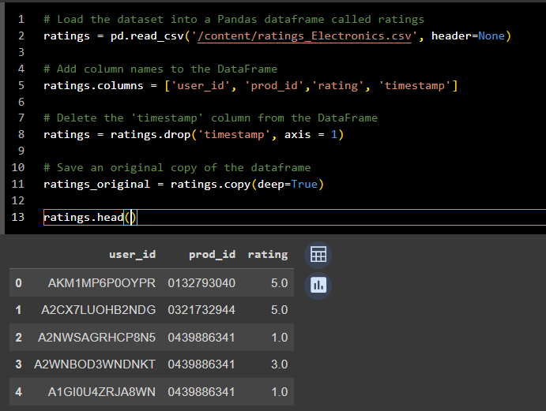
Data Cleaning
Four columns were in the DataFrame ‘user_id,’ ‘prod_id,’ ‘rating,’ and ‘timestamp.’ The timestamp was not essential for the analysis, so it was deleted from the DataFrame.

Slide 4
Exploratory Analysis

Slide 5
Checking the shape and size of the data
Checking the shape of the data reveals that the number of rows is 7,824,482, and there are three rows in the DataFrame names ratings. The number of rows represents the total number of ratings, while the number of columns indicates the different attributes associated with each rating.

Slide 6
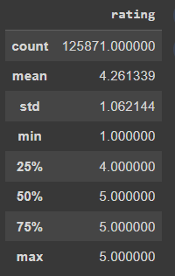
Summary statistics of ‘rating’
Statistics Definition
Count: The total number of non-null entries in the rating column is 125,871.
Mean: The average value of the ratings in the “rating” column is approx. 4.26.
Std: the standard deviation of the ratings, is approx. 1.06, indicating moderate variability in ratings.
Min: the minimum rating value observed in the “rating” column is 1.
25%: this means that 25% of the ratings are at or below 4.
50%: This means that 50% of the ratings are at or below 5.
75%: This means that 75% of the ratings are at or below 5.
Max: The maximum rating value observed in the “rating” column is 5.

Slide 7
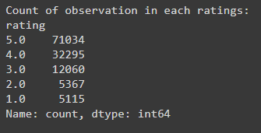
Distribution of ratings
5.0 is the most common rating, followed by 4.0, and ratings 3.0, 2.0, and 1.0 have progressively fewer observations.

Slide 8
Number of unique users and items in the dataset
The more significant number of unique items compared to the number of unique users suggests a diverse set of items being rated or interacted with by users.

Slide 9
Exploratory Data Analysis
The dataframe has 65,290 rows with 3 columns.
Checking the number of rows and columns

Slide 10
Checking for Null values
The numbers shown (0) represent the missing values in each column.
There are no null values in these columns, ensuring that there is complete data to work with.
Column name | Null count
User_id | 0
Prod_id | 0
Rating | 0

Slide 11
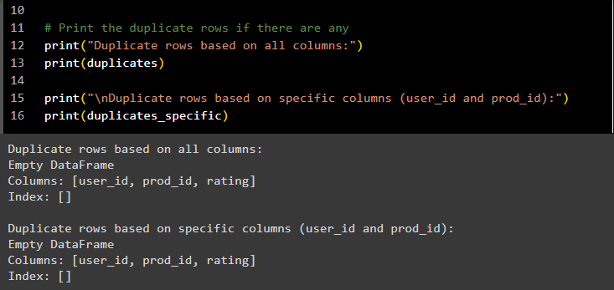
Checking for duplicates
The output indicates that there are no duplicates in the DataFrame. This reduces the chance of the data being skewed or leading to incorrect conclusions.

Slide 12
Data Type Validation
The DataFrame has 125,871 entries and no null values (‘Non-Null Count’ for each column equals the total number of entries. The memory usage of the DataFrame is approximately 3.8 MB.
The ‘user_id’ and ‘prod_id’ columns contain categorical or string data, such as user identifiers and product identifiers
The ‘rating’ column contains numerical data in the form of ratings, stored as floating-point numbers
Column | Non-Null | Count | Dtype
User_id | 125871 | Non-null | Object
Prod_id | 125871 | Non-null | Object
Rating | 125871 | Non-null | float64

Slide 13
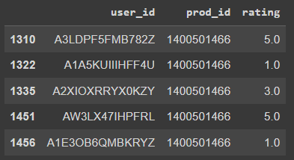
Overview of the dataset
The name of the dataset is ratings_Electronics.csv; it is composed of 665,290 rows and has 3 columns. The dataset is a database tracking customer IDs, the products purchased, and the ratings customers provided on the products purchased. The dataset has four columns titled ‘user_id,’ ‘product_id,’ ‘rating,’ and ‘timestamp.’ The user_id is an alphanumeric string variable, the prod_id is a numeric string variable, the rating is a decimal, float64 variable, and the timestamp is a temporal variable. While there are four columns in the dataset, only the three columns specific to customer product ratings will be used, excluding the timestamp column.

Slide 14
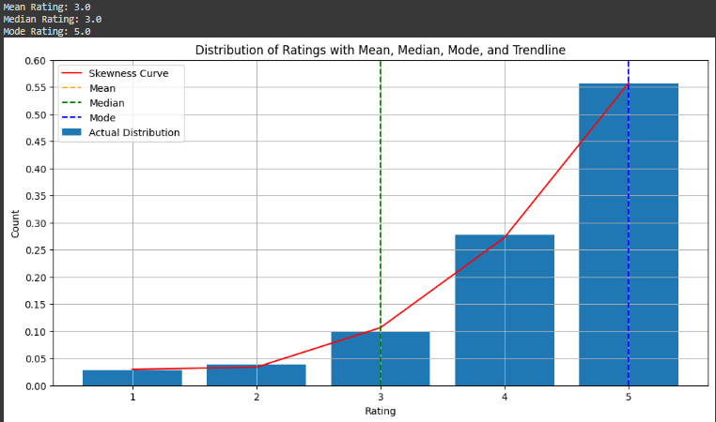
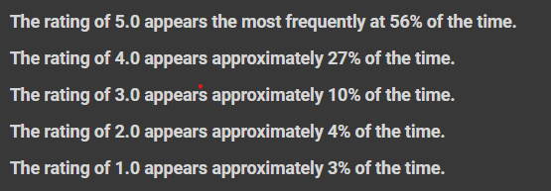
Bar Chart of rating distribution
The rating distribution is skewed to the left (negatively skewed) indicating that the bulk of the ratings is concentrated towards the higher end of the rating scale, and fewer ratings are towards the lower back. In this type of situation, the mode is frequently more significant than the mean.
A mode of five suggests that many users gave a rating of five more frequently than other ratings.
With the mean and the median both being three, it suggests that while there are some higher ratings, there are also lower ratings, dragging the average down to three. Insinuating some variability in the ratings, with a portion of the ratings being lower than three

Slide 15
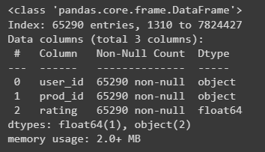
Exploratory Data Analysis
User_id is of the object type
Prod_id is of the object type
Rating is of the float64 type
Checking Data Types and Observations

Slide 16
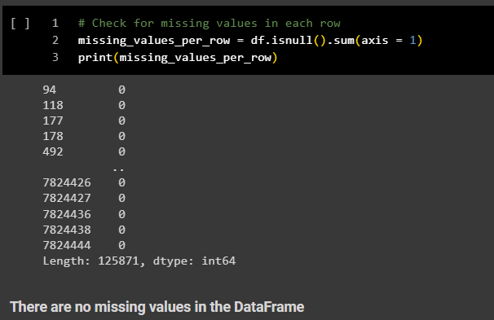
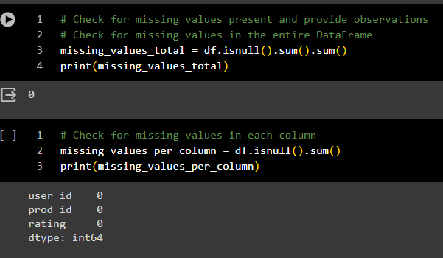
Exploratory Data Analysis Check for Missing Data
There were no missing data or null values in any of the rows or columns; thus, we can conclude that there is no missing data or null values in the dataframe.

Slide 17
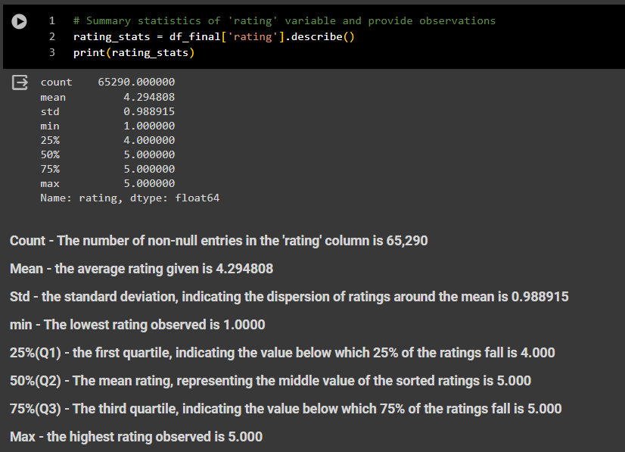
Summary Statistics
When we compare the median and the mean, the mean is slightly lower than the median, suggesting that the distribution is slightly left skewed, influenced by a few lower ratings.
The low standard deviation (std.) suggests that the ratings are closely clustered around the mean.
The range for the minimum and maximum are simplistic, from 1 to 5, with 1 being the low satisfaction rating and 5 being the highest level of satisfaction.
Since the median is equal to the 75th percentile, it suggests that the data is skewed to the right, meaning there may be higher ratings compared to lower ratings. (as depicted in the following bar graph.)

Slide 18
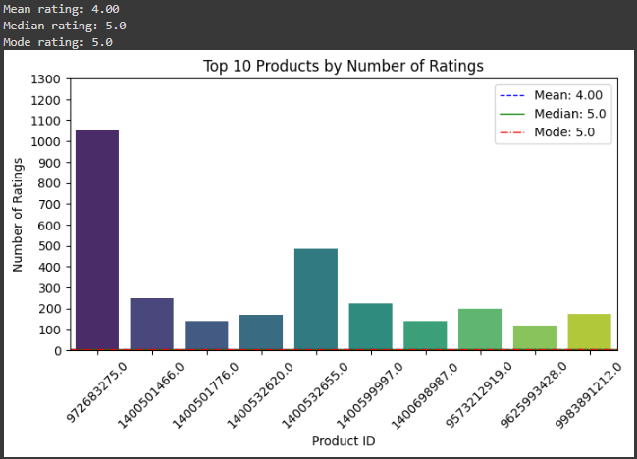
Rating Distribution
Overall Satisfaction – the high mean and mode indicate a general trend of high user satisfaction with the products.
Negatively Skewed – The median and mode higher than the mean suggest a negatively skewed distribution, where most ratings are at the higher end of the scale.
Reliability of Ratings – the fact that the median and mode are both 5.0 might suggest that a majority of users consistently rate products very highly, which could be due to genuinely good product quality or potentially rating biases.

Slide 19
Number of unique users and Products in the DataFrame
The number of unique Users in the raw data is 65,290
The number of unique Products in the raw data is 5,689

Slide 20
Model Development

Slide 21
Model 1: Rank Based Recommendation System
The top entries in the table show products with tens of thousands of ratings, indicating high consumer engagement and popularity. As the rank increases, the number of ratings dramatically decreases.
The highest-ranked product (prod_id: B0074BW614) has 18,2244 ratings occupying the top position. The product ranked second (prod_id: B00DR0PDNE) has a substantial drop in rating count to 16,454, suggesting that many products have similar rating counts, which leads to significant jumps in rank.
Products with higher ranks likely have greater visibility on the platform, influencing customer purchase decisions (possibly caused by the platform’s recommendation algorithms favoring more outstanding ratings.)

Slide 22
Model 1: Rank Based Recommendation System

Slide 23
Recommending top 5 products with 50 minimum interactions based on popularity
This recommendation code lists the top 5 products based on the number of interactions, which have significantly surpassed the minimum requirement of 50 interactions.
Product Focus –B0074BW614, B00DR0PDNE, B0019EHU8G, B006GW05WK; are identified as the most popular products.
Interaction Counts – These are very high, ranging from 12,226 to 18,244, indicating that these products are trendy among users.
Average Ratings – vary from 3.93 to 4.75, showing that these products are popular and well-regarded, generally receiving favorable ratings.

Slide 24
Recommending top 5 products with 100 minimum interactions based on popularity
This recommendation code lists the top 5 products based on the number of interactions, which have significantly surpassed the minimum requirement of 100 interactions.
Product Focus –B0074BW614, B00DR0PDNE, B0019EHU8G, B006GW05WK; are identified as the most popular products.
Interaction Counts – These are very high, ranging from 12,226 to 18,244, indicating that these products are trendy among users.
Average Ratings – vary from 3.93 to 4.75, showing that these products are popular and well-regarded, generally receiving favorable ratings.

Slide 25
Top ten products based on minimum interactions

Slide 26
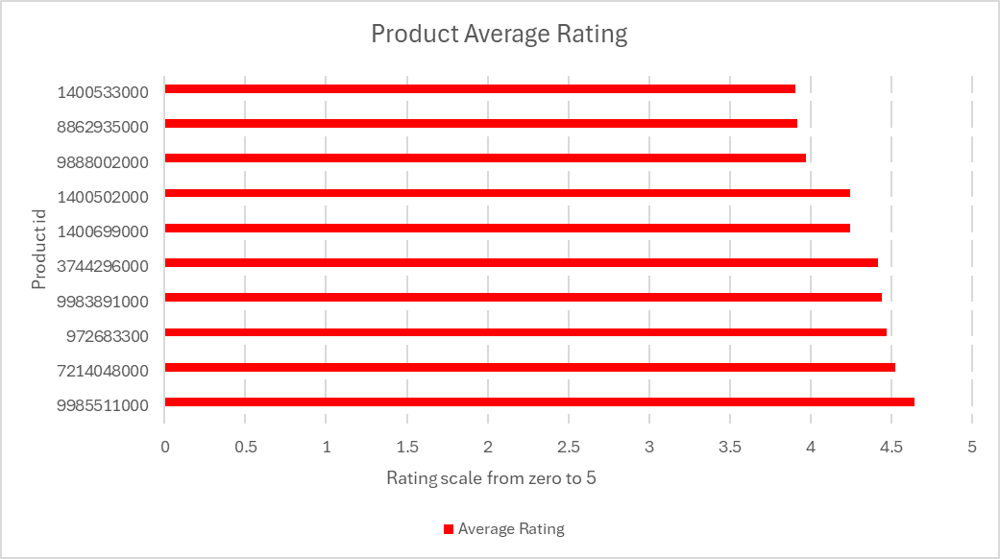
Top ten products based on highest average rating

Slide 27
Model 2: Collaborative Filtering Recommendation System

Slide 28
The Precision score of 0.7728458064 rounded to two decimal points 77.28 indicates that 77.28% of the items recommended by the model were relevant to the users.
0.5237592038952193 or 52.37% measures the model's ability to find all the relevant cases (true positives). A recall of 52.37% indicates that the model successfully identified about half of all the relevant items.
An F1 score of 0.4589, which is the harmonic mean of precision and recall, provides a single metric that balances both. This score suggests that the model is not highly effective at balancing recall with precision, indicating a potential need for improvement, particularly in recall.
Average Precision@k: 0.7728665981492696
Average Recall@k: 0.5237593881084158
Average F1 score@k: 0.45894648132703303

Slide 29
Strategic Insights and Further Analysis
Product Focus: These products could be central to marketing campaigns, inventory planning, and further analysis to understand why they are popular.
Review Text Analysis: Combining these ratings with textual reviews could provide deeper insights into the reasons behind their popularity or issues.
Temporal Analysis: Analyzing how the popularity of these products changes over time could inform dynamic marketing strategies and stock management.
Comparison with Sales Data: Aligning this analysis with actual sales data could verify if high interaction counts translate directly into high sales.
Comparison of recommendation products with 50 and 100 interactions

Slide 30
Key Points from Similarity of Both Outputs
Analysis of Similarity
The similarity in outputs for thresholds of 50 and 100 interactions demonstrates the dominance of the top products in your dataset and their appeal to a broad user base. For strategic decision-making, this indicates that these products are likely central to customer interest and could be critical drivers of traffic and sales. Further exploration with varied thresholds and additional data (like sale figures, customer demographics, and seasonal trends) would provide deeper insights into the dynamics of product popularity and customer preferences.
Both outputs list the same products with their respective interaction ratings.

Slide 31
Model 2: Collaborative Filtering Recommendation System
Building a baseline user-user similarity-based recommendation system using the SGDRegressor

Slide 32
user_user Similarity-based Recommendation System

Slide 33
Building the user-user Similarity-based Recommendation System
Average precision and Recall: Both metrics reported as 1.0, which is an unusually perfect score.
This suggests that in each chunk, every prediction made by the model for items with true ratings of 4 or 5 was correct, and all items that should have been recommended (true positives) were indeed recommended.
Total Chunks processed: The script processed 783 chunks, indicating a robust dataset.

Slide 34
Predicting rating using the user-user Similarity-based Recommendation System
The prediction output indicates that the user ID ‘A3LDPF5FMB782Z’ and the item ID ‘1400401466’ are used for the prediction.
The actual rating provided by the user is 5.00 (‘r-ui =5.00’), while the estimated rating predicted by the model is 4.19 (‘est = 4.19’).
However, the output includes a warning (‘{‘was_impossible’: True, ‘reason’: ‘User and/or item is unknown.’}’), which indicates that the prediction is unreliable because the user ID and/or item ID is not present in the training data.
User: A3LDPF5FMB723Z, item: 140050466, r-ui = 5.00, est=4.19
(was ‘impossible’: True, ‘reason’: ‘User and/or item is unknown.

Slide 35
Predicting rating using the user-user Similarity-based Recommendation System
The prediction output indicates that the user ID ‘A3LDPF5FMB782Z’ and the item ID ‘1400401466’ are used for the prediction.
The actual rating provided by the user is 5.00 (‘r-ui =5.00’), while the estimated rating predicted by the model is 4.19 (‘est = 4.19’).
However, the output includes a warning (‘{‘was_impossible’: True, ‘reason’: ‘User and/or item is unknown.’}’), which indicates that the prediction is unreliable because the user ID and/or item ID is not present in the training data.
User: A34BZM6S9L7QI4, item: 140050466, r-ui = 5.00, est=4.19
(was ‘impossible’: True, ‘reason’: ‘User and/or item is unknown.

Slide 36
Improving Similarity-based Recommendation system by tuning its hyperparameters

Slide 37
Improving Similarity-Based Recommendation System by tuning its hyperparameters
The RMSE for the user-user similarity-based model is 1.020.
The RMSE for the Similarity-based recommendation system by tuning its hyperparameters is 0.9784.
The lower RMSE score indicates that tuning the hyperparameters of the ‘BaselineOnly’ algorithm has led to better performance.
User-User similarity-based model RMSE score: 1.020
Hyperparameter model RMSE score: 0.9783
The hyperparameter tuning has improved the performance of the user-user similarity-based model.

Slide 38
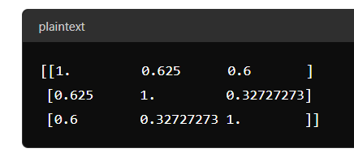
Implementing the recommendation algorithm based on optimized KNNBasic model
User 1 and User 2 :
Similarity score: ‘0.625’
Indicates a moderate similarity between their rating patterns.
User 1 and User 3:
Similarity score: ‘0.6’
Indicates a moderate similarity between their rating patterns
User 2 and User 3:
Similarity score: ‘0.327’
Indicates a lower similarity between their rating patterns compared to the similarity between User 1 and User 2, or User 1 and User 3
User ID A3LDPF5FMB782Z was not found in the dataset.

Slide 39
Item-Item Similarity-based Collaborative Filtering Recommendation System

Slide 40
Identifying similar Users to a given User (nearest neighbor)
This code retrieves the five nearest neighbors for user 0.
The output indicates successful dataset loading and similarity matrix computation, followed by identifying the nearest neighbors.
The nearest neighbors are: [130, 297, 690, 747, 810]

Slide 41
Identifying similar items to a given item (nearest neighbors)
Nearest neighbors for item with internal id 0:
Item ID: 1081
Item ID: 1444
Item ID: 842
Item ID: 1110
Item ID: 812

Slide 42
Model 3: Matrix Factorization
0.9214866212459717 indicates that the model’s predicted ratings deviate from the actual ratings by 0.9215 units. As the rating scale is from 1 to 5, this is a solid result, making reasonably accurate predictions.
Best Hyperparameters: ‘n_factors’:100 – This describes the number of latent factors.
‘n_epochs’:30 – describes the number of iterations over the training data.
‘lr_all’: 0.01 – describes the learning rate for all parameters
‘reg_all’: 0.1 – describes the regularization term for all parameters.
Best RMSE: 0.9214866212459717
Best Hyperparameters:
{‘n_factors’: 100, ‘n_epochs’: 30, ’lr_all’:0.01, ‘reg_all’: 0.1}
Predicted rating for user A3LDPF5FMB782Z and product 1400501466: 3.52986
The model suggests that user A3LDPF5FMB782Z would rate product 1400501466 with a score of 3.53.

Slide 43
Improving Matrix Factorization based recommendation system by tuning its hyperparameters
An RMSE of 0.9211 is a solid result for a recommendation system with a rating from 1 to 5. it means that, on average, the model’s predictions are within approximately 0.92 units of the actual ratings.
N_factors:100 determines the number of latent factors in the model
N-epochs: 30 defines the number of iterations the algorithm will run during training.
Lr_all: 0.01: This is the learning rate for all parameters.
Reg_all: 0.1: This parameter represents the regularization term for parameters
Best RMSE: | 09210559505865746
Best hyperparameters: | {‘n_factors’: 100, ‘n_epochs’:30, lr_all’, ‘reg_all’: 0.1}
RMSE: | 0.7592
RMSE: | 0.7592425682562741
MAE: | 0.6043
MAE: | 0.6043479441572124
User ID A3LDPF5FMB782Z | Not found in dataset

Slide 44
Predict the rating for a user with userid = ‘A3LDPF5FMB782Z’ and prod_id = ‘1400501466’
Best RMSE: 0.9219985083828731
Best hyperparameters: {‘n_factors’: 100, ‘n_epochs’: 30, ‘ir_all’:0.01, ‘reg_all’:0.1
Predicted rating for user A3LDPF5FMB782Z: 3.52986

Slide 45
Predict the rating for a user with userid = ‘A34BZM6S9L7Q14’ and prod_id = ‘1400501466’
Best RMSE: 0.9214818962408079
Best hyperparameters: {'n_factors': 100, 'n_epochs': 30, 'lr_all': 0.01, 'reg_all': 0.1}
Predicted rating for user: A34BZM6S9L7Q14 and product 1400501466: 3.52986

Slide 46
Conclusion
The Amazon dataset was a huge dataset to analyze, containing 7,824,481 rows. This made processing very difficult and slow. It became necessary to move from a local machine using Python, Juypter Notebook to cloud-based computing to increase the speed of processing and incorporate handling procedures such as sampling to create smaller, manageable subsets for model training. Parallel processing to speed up computations. Libraries like Dask or Spark help manage large datasets efficiently. Batch processing to group tasks together and achieve higher efficiency and throughput. To reduce the overhead associated with starting and stopping individual tasks.
In the future, it would be prudent, especially for large or extremely large datasets, to utilize handling methods such as sampling, parallel processing, and Libraries such as Dask or Apache Spark to reduce the time required to process data. Additionally, if resource use is an issue, cloud-based computing, due to its scalability, cost efficiency, flexibility, managed services, and access to advanced technologies and security features, can efficiently process and analyze large volumes of data, enabling faster insights and better decision-making while minimizing the complexities and costs associated with maintaining on-premises infrastructure.

